Slide 1
Weekly report
Week 19(14/3/2014-18/3/2014)
1/6
Admission system – DeadlineTeam – Mentor: Mr. Bui Minh Phung

Slide 2
Agenda
Last week’s accomplishments
Plan for next week
2/6
Admission system – DeadlineTeam – Mentor: Mr. Bui Minh Phung

Slide 3
Last week’s accomplishments
Coding công cụ quản trị system
Release sprint 1
Prepare and start sprint 2
3/6
Admission system – DeadlineTeam – Mentor: Mr. Bui Minh Phung

Slide 4
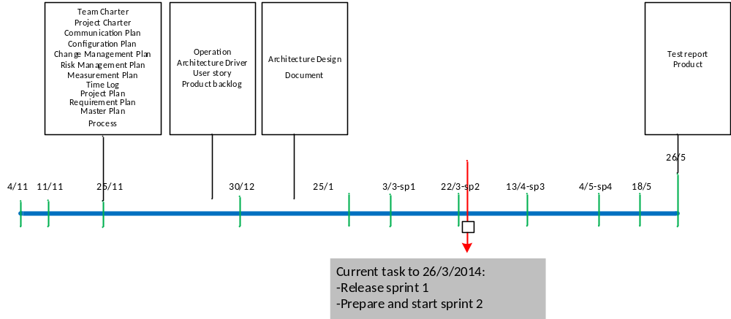
Last week’s accomplishments
3/6
Admission system – DeadlineTeam – Mentor: Mr. Bui Minh Phung

Slide 5
TIME LOG
3/6
Admission system – DeadlineTeam – Mentor: Mr. Bui Minh Phung

Slide 6
TIME LOG from start project
3/6
Admission system – DeadlineTeam – Mentor: Mr. Bui Minh Phung

Slide 7
Plan for next week
Detail design for sprint 2.
Coding for cong cu quan tri system.
Coding for cong cu hien thi system
5/6
Admission system – DeadlineTeam – Mentor: Mr. Bui Minh Phung

Slide 8
Thanks for your attention

